Slide 1

NBA players' performances on court: A Tableau visualization project
Yihang Fu, Xueting Li, Jingheng Huan

Slide 2
Data Scraping using Weibo Scraper
Objective:
To gather real-time public opinion about NBA players from a Chinese audience.
How It Works:
Filter out Weibo that has “NBA” and “shooter” these two keywords and are posted in 2023.

Slide 3
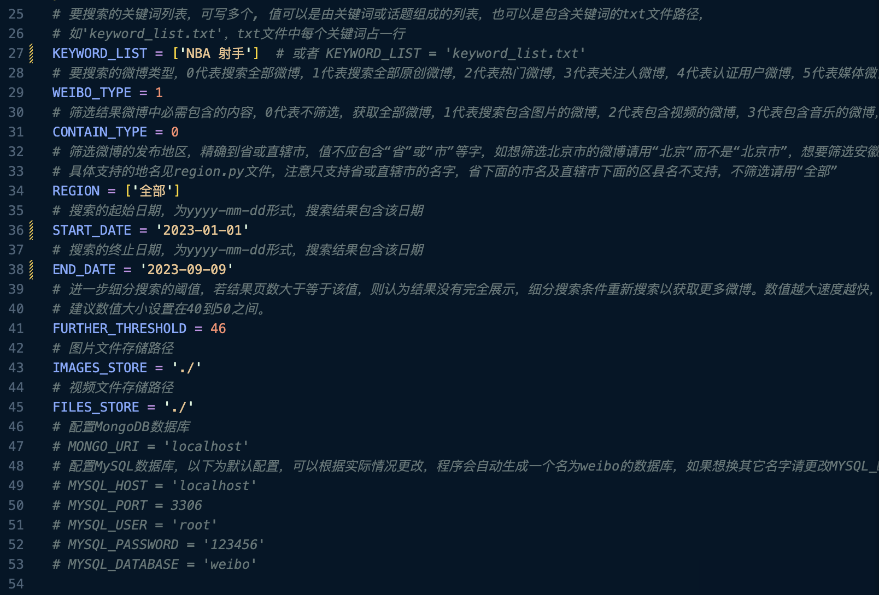
How to Customize Weibo Data Scraper?

Slide 4
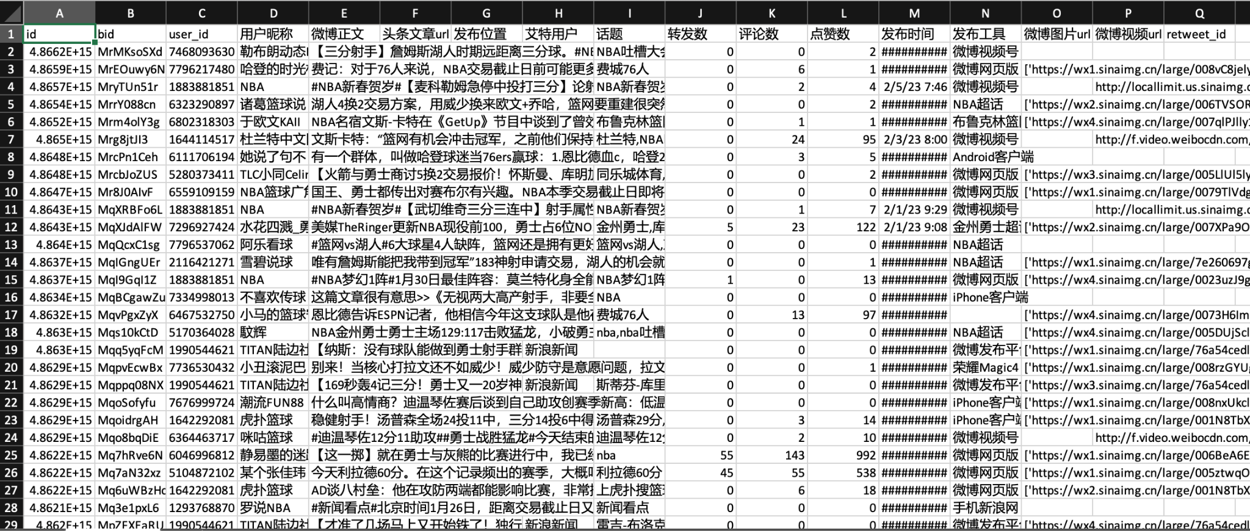
Snippet of Scraped Weibo Dataset

Slide 5
Word Cloud
Objective:
To visualize the frequency of words associated with NBA top 20 shooters on Weibo.
Methodology:
Remove stop words
Tokenization Problem and Solution:
Green: Draymond Green / Danny Green
Gordan: Aaron Gordan / Eric Gordan
Klay Thompson: Klay / Thompson / KT
word stemming / N-grams (bigram)

Slide 6
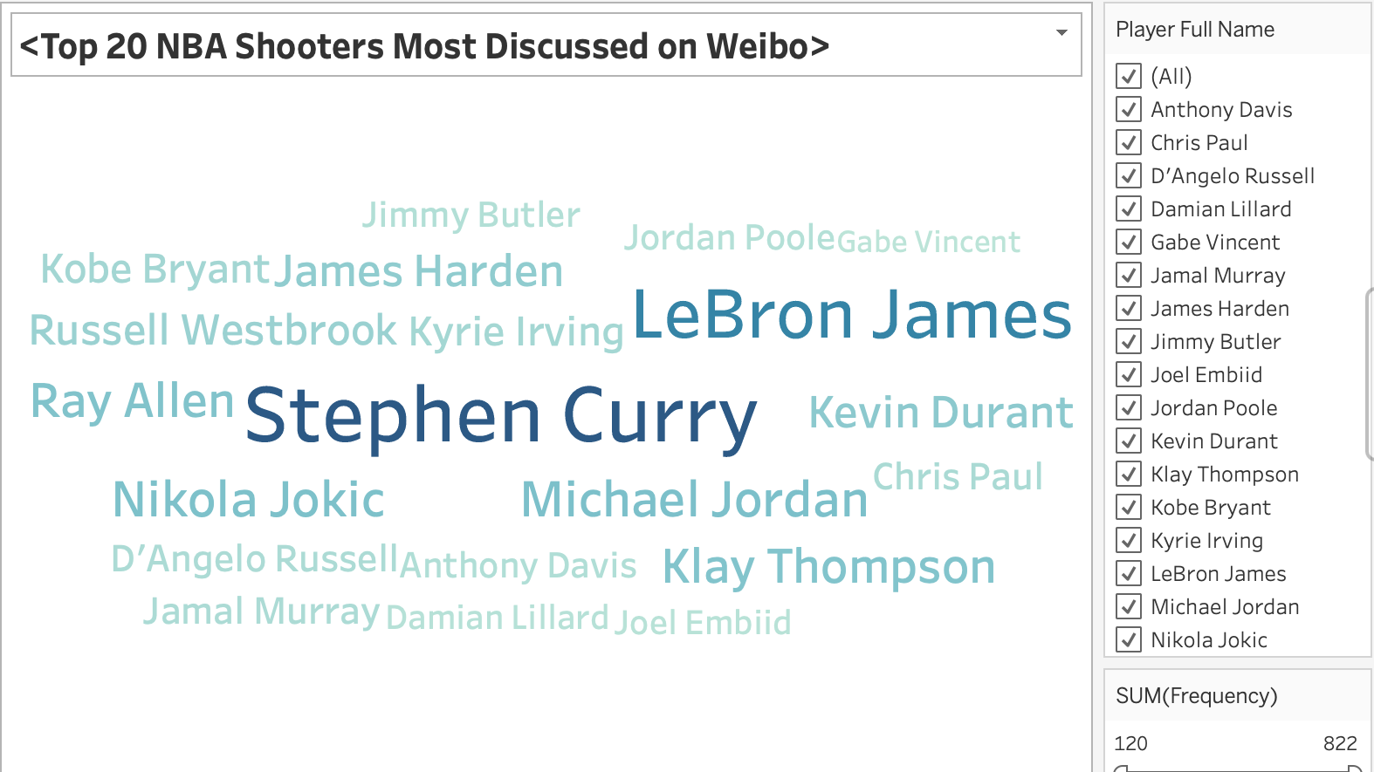
Word Cloud

Slide 7
NBA Player Shot Chart – Data Query
Parameters | Data Type | Descriptions
X_loc | Float | The X-coordinate of the shot location on the court (in basketball court units).
Y_loc | Float | The Y-coordinate of the shot location on the court (in basketball court units).
Shot_distance | Float | The distance from the basket where the shot was attempted (in feet).
shot_area | String | The area of the court where the shot was attempted (e.g., "Center(C)" for shots in the center).
shot_type | String | The type of shot (e.g., "2PT Field Goal," "3PT Field Goal").
made | Boolean | Whether the shot was made (true) or missed (false).
We use the
nba_api - shotchartdetail function to query players’ shot detail data.
In our project, we take use of several parameters of this function. Namely, X_loc, Y_loc, shot_distance, shot_area, shot_type and made.

Slide 8
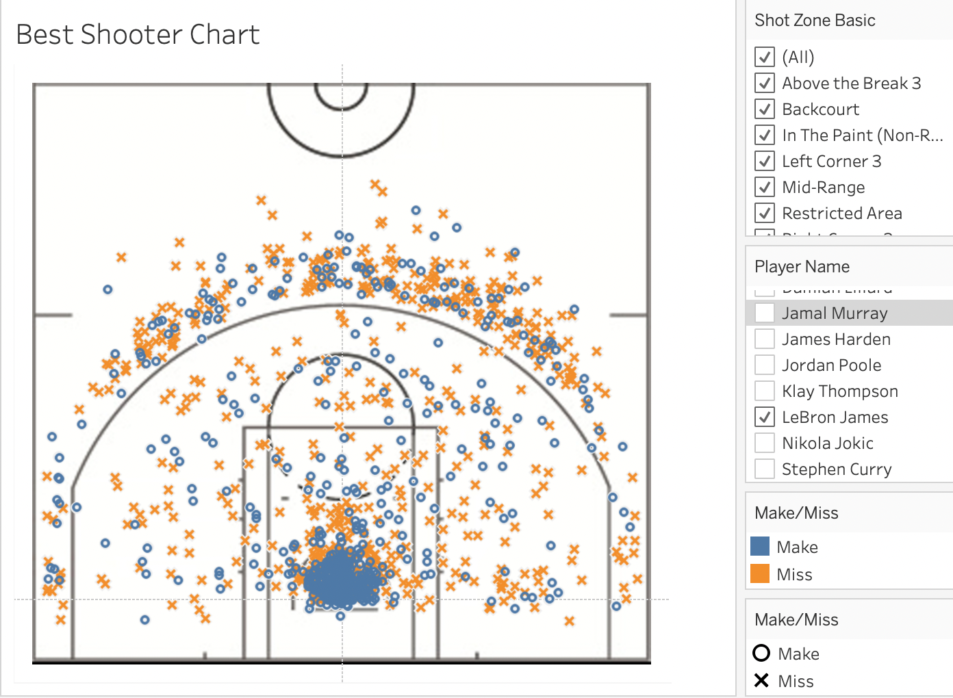
NBA Player Shot Chart – Visualization
After importing the shot coordinates, we inserted a map, which is a basketball half-court sketch to carry these shot spots. One thing need to be careful is that the parameters of the map (for example the range) should be well-adjusted to match the shot coordinates. We finally added more build-in filters, such as shot zone, shot type, etc for more interaction options.

Slide 9
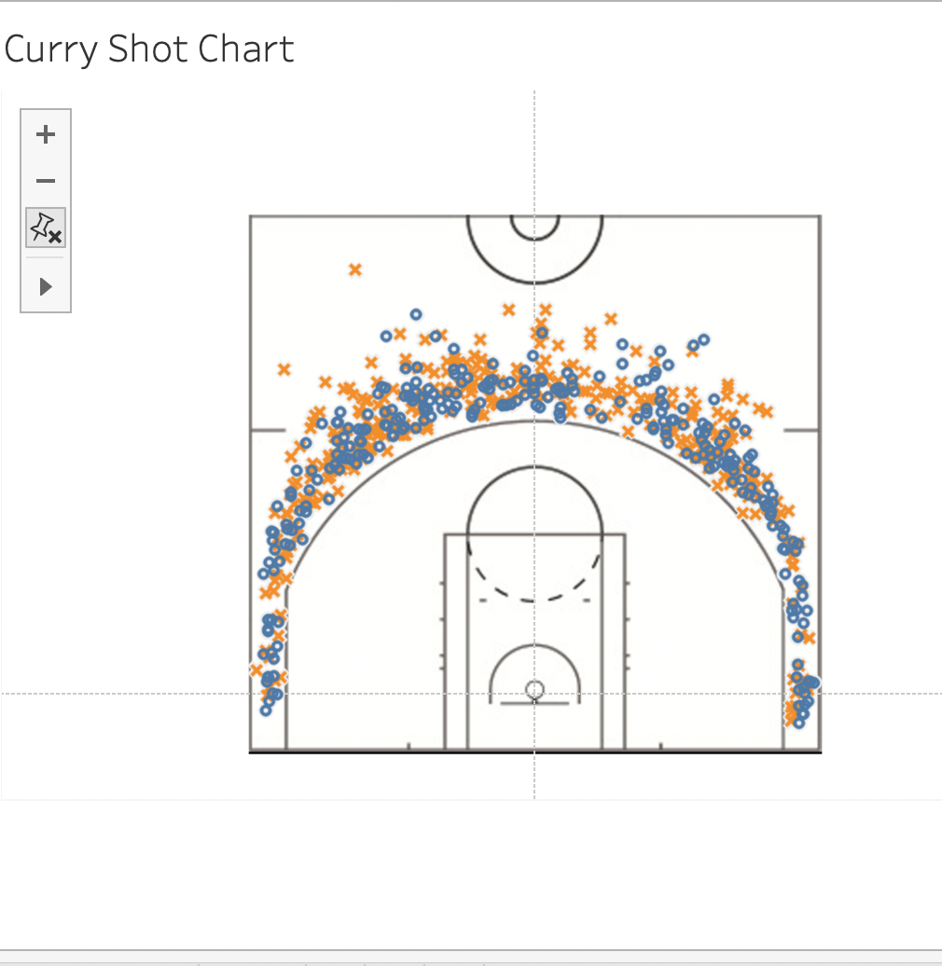
NBA Player Shot Chart – Visualization
The Shot Chart shows the specific shot performances at the court. The blue dots are the shots made by the players and the yellow signs are the miss shots of the players. Furthermore, we can select a specific player and see more information of his shooting performance.

Slide 10
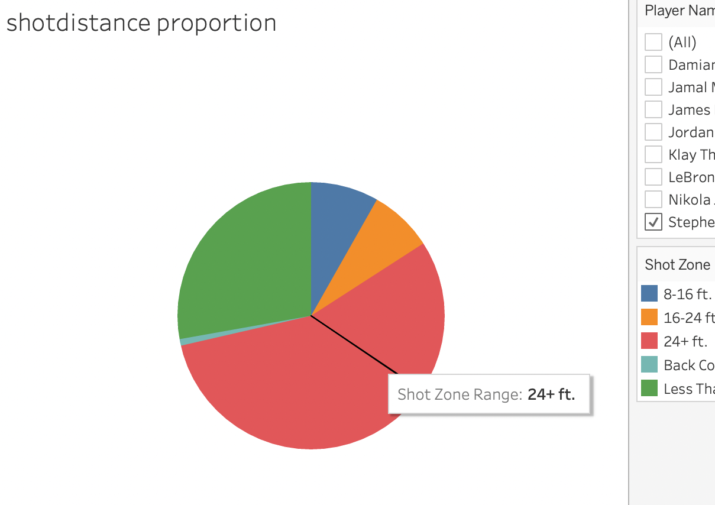
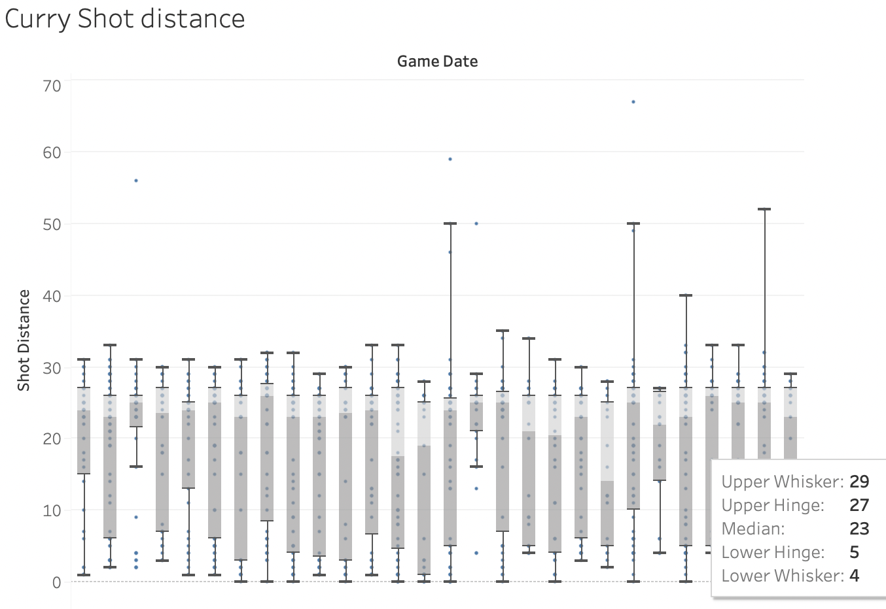
NBA Player Shot Chart – Visualization

Slide 11
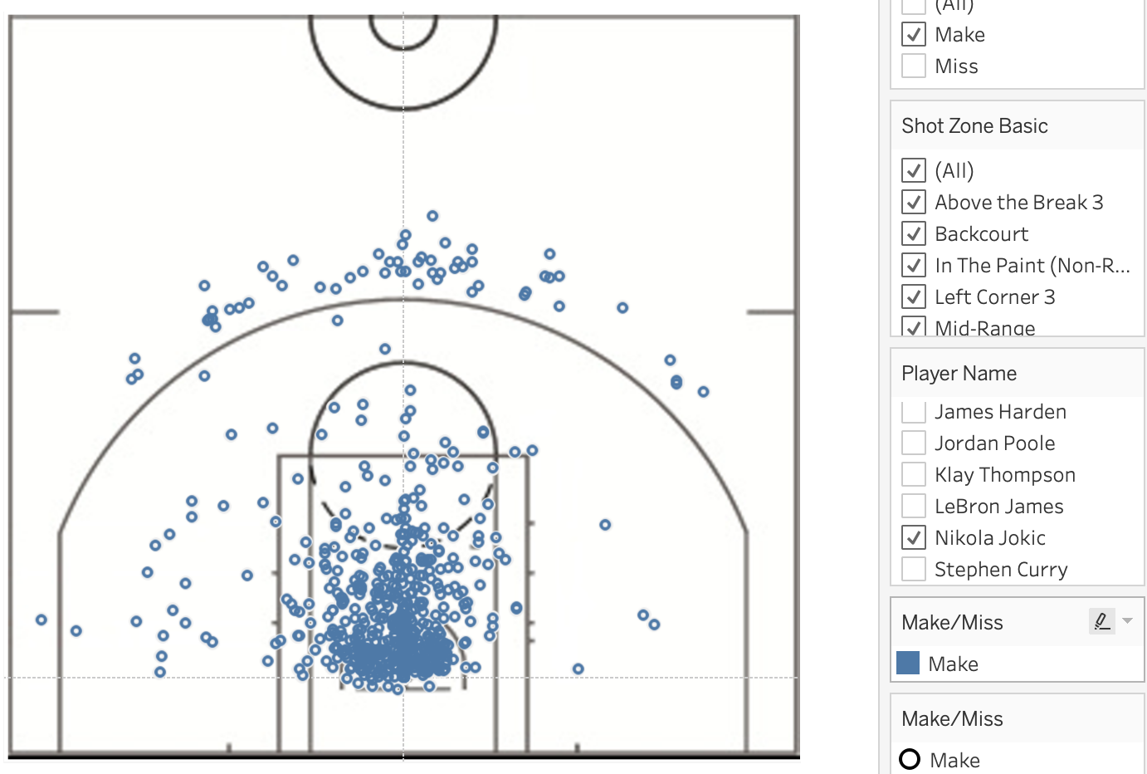
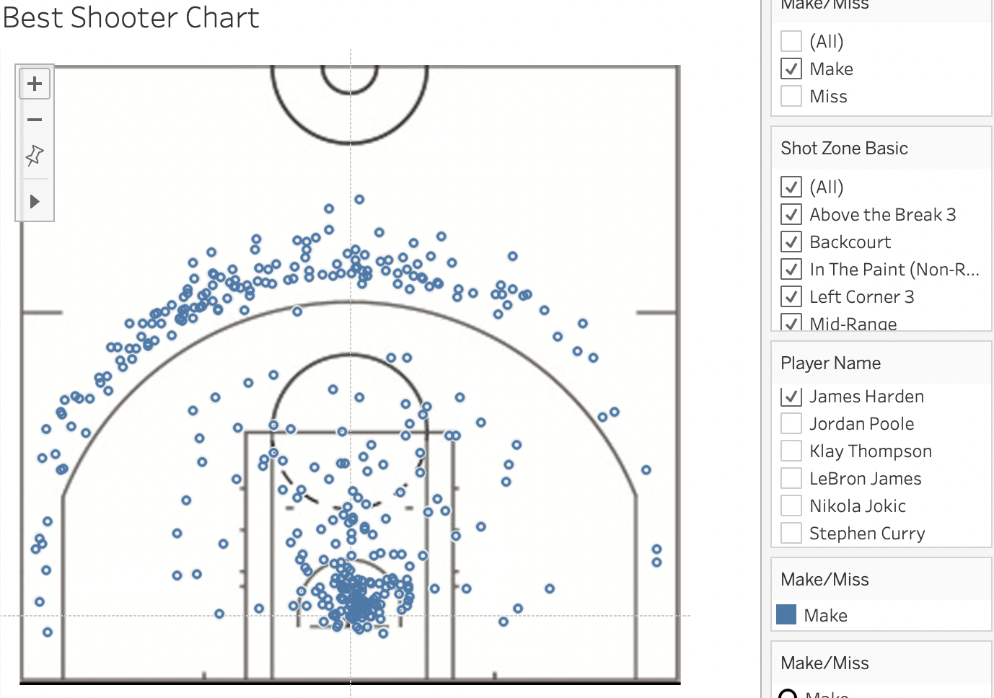
NBA Player Shot Chart – Discussion and Limitation
NBA players nowadays prefer more 3-point shootings, no matter the positions on the court.
Guards shoot more productively 3-points, but they have different preferred shot zones, and they have higher accuracy at certain zones.

Slide 12
Shot Chart doesn’t tell the whole story
The Shot charts could not provide more direct quantitative data visualizations, for example the number of shots made at certain areas and the temporal information.
Shot charts primarily focus on displaying the locations of shots made and missed on the basketball court.

Slide 13
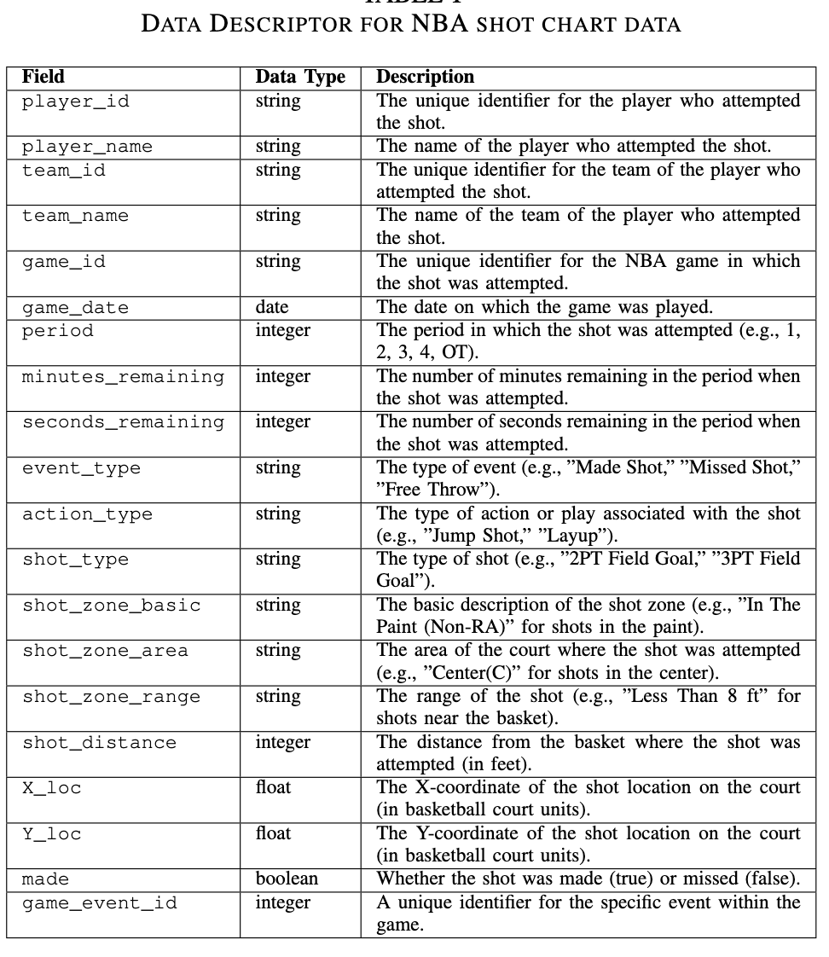
NBA Player Attributes Radar Chart – Data Query

Slide 14
Radar Chart
Five dimensions:
scoring (PTS), shooting (FG3_PCT), rebound (REB), defense (Defense), assist (AST).

Slide 15
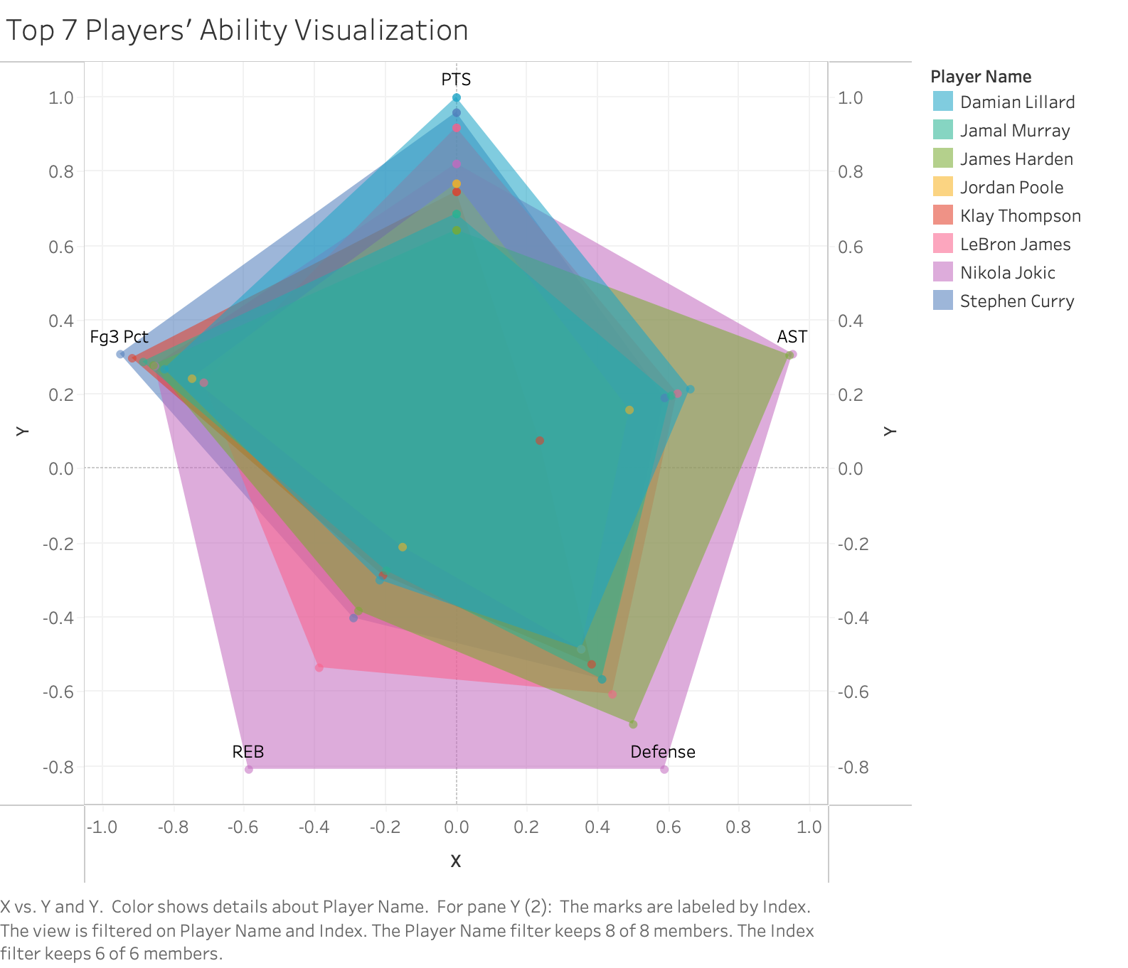
Radar Chart

Slide 16

Thank you!

